Slide 1
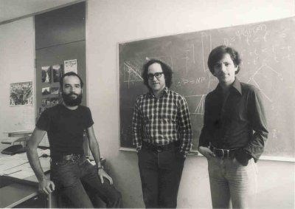
RSA Cryptography
left to right: Adi Shamir, Ron Rivest, and Len Adleman

Slide 2
Why pay attention? Not on the exam.
RSA Cryptography is one way information is securely passed over the internet.
I’ll cover how you how you can become rich and famous. Really.
15 slides and some code in VS Code

Slide 3
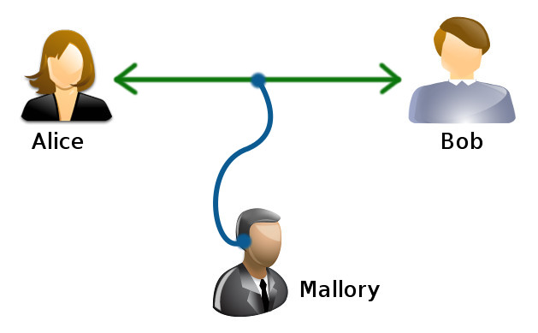
Cryptography – the problem
Eve
In the classic problem description, Alice needs to send a message to Bob. Eve is trying to intercept the message and read it.

Slide 4
Early Cryptography – letter substitutions
ABCDEFGHIJKLMNOPQRSTUVWXYZABCDEFGHIJKLMNOPQRSTUVWXYZ
ABCDEFGHIJKLMNOPQRSTUVWXYZ
To Encode P - > A, Q->B, etc
To Decode: A -> P, B->Q, etc
The table for encoding and decoding is called the codebook. Somehow, you must securely get codebooks to everyone who might need to read your message. Wait, in order to send a secure message, you first need to send a secure message? This is a problem.

Slide 5
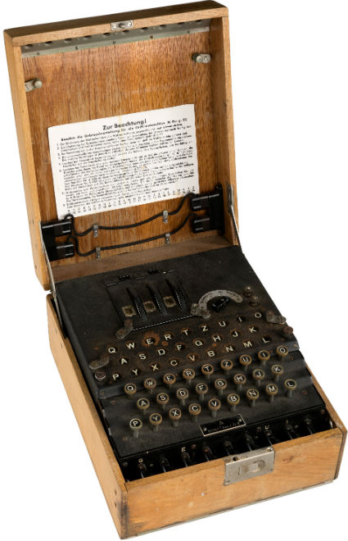
World War II – 1940s
German enigma machine was state of the art for encoding and decoding messages in the German navy.
It scrambled letters so well it was considered unbreakable. But it still needed a book to tell operators which dials to put in the machine.
Pressing a letter produced a different letter every time.
The British broke the code by creating the first working computer.
https://www.101computing.net/enigma-machine-emulator/

Slide 6
1970s – Public Key Cryptography
What if there was a way to make the codebook public? You could print the codebook in the New York Times. The messages would be secure even when everyone has a copy of the codebook. That’s revolutionary.
The idea is that the receiver, Bob, chooses two prime numbers. He publishes the product of the numbers but not the two numbers themselves. The product of the numbers is the public key. The numbers themselves are his private key.
This method is secure as long as no one figures out how to factor really big numbers into their two primes.

Slide 7
There is a little more to it – Bob gathers these numbers
p – choses a big prime number
q – choses another big prime number
n – q times p – this is an even bigger number
E – a random integer that is relatively prime to (p-1)(q-1).
gcd( E, (p-1)(q-1) ) = 1
D – the multiplicative inverse of E mod (p-1)(q-1)
E D = 1 mod (p-1)(q-1). E and D are inverses mod (p-1)(q-1)
P is the message to send. The message is converted to an integer by just interpreting the bytes of the message as a big integer.

Slide 8
Sample 256 bit numbers https://asecuritysite.com/encryption/getprimen
p = 58851542024877078402255446455754399837369296150065655669525230393703140801269
q = 114026257070028578600599060422975669480620595100786709305074977820711934076933
n = p * q = 6710621059896223971760292187102491524668433156332152278971663530734612756187345454315184224981953688354940883181597234884329944331172404575554375510027977
(p-1)(q-1)= 6710621059896223971760292187102491524668433156332152278971663530734612756187172576516089319324950833848062153112279244993079091966197804367339960435149776
E= 65537
D=3863749867618659922645267030656353131694137002319871738021526033671664521445393747078110294572648958060679879847090117499562788291385140454967515557012705

Slide 9
A text message as a integer?
Example: “We attack at dawn!” -> 7613180436432796759363040757764455172369953
We use a table to go from characters to numbers between 0-255. For instance, ‘a’ is 65. Then we think of all those numbers in binary 1’s and 0’s and interpret them as a big binary number.

Slide 10
RSA Cryptography – who knows what
Bob’s public key: (n, E)
Alice, the Sender
P : The message
Bob, the Receiver
p, q : two big primes
n = p times q
E is relatively prime to (p-1)(q-1)
D = E⁻¹

Slide 11
Sending and receiving
Alice needs to encrypt her message, P. She looks at Bob’s public key (n, E) and computes the encrypted message C:
C = P^{E} mod n
Bob receives the encrypted message, C, and decrypts P back
P = C^{D} mod n

Slide 12
Eve intercepts the encrypted message C
Eve sees C. She only knows (n, E), not p or q. She needs to compute D, the inverse of E mod (p-1)(q-1) but she can’t without knowing p and q.
Decrypt math: P = C^{D} mod n
She decides to try to factor n into p and q. Factor this:
6710621059896223971760292187102491524668433156332152278971663530734612756187345454315184224981953688354940883181597234884329944331172404575554375510027977
This n is 512 bits which can be cracked in 4 hours. Current standard is 1024 bit p,q for corporate use. 1024 bit cracking needs 15million computers running for a year. Eve can’t keep up.

Slide 13

How to become rich and famous doing math?
Come up with a new way to factor very large numbers into two primes.
There was a 1992 movie about a team that breaks all codes. It is implied that they find a way to factor large numbers, thus making all the public key encrypted messages readable.
Watch out for Quantum Computing

Slide 14
How to code RSA in Java
The built in types use too few bits
Type | Number of bits | Largest number
byte | 8 | 2^8 = 256
short | 16 | 2^16 = 65536
int | 32 | 2^32 = 4294967296
long | 64 | 2^64 = 18446744073709551616
Java has the BigInteger class for very large integers

Slide 15
Java BigInteger
Java doesn’t support using operators such as ‘+’, ‘-’, ‘*’, ‘/’ on classes.
BigInteger a = BigInteger.ONE;
BigInteger b = new BigInteger(“20”);
BigInteger c = a.add(b); // c = a + b. c is BigInteger 21.
Additional useful functions:
BigInteger P = new BigInteger(“84032580468043585042358”);
P.modPow(BigInteger E, BigInteger n) to implement
P^{E} mod n
It also has modInverse(BigInteger m) to determine the modInverse D.
You get the idea that BigInteger was made for cryptography.

Slide 16
See it all put together in VS Code

